Slide 1
Churn Prediction Project
POC – Customer Analytics
January 3th, 2018
Richard Vogg

Slide 2

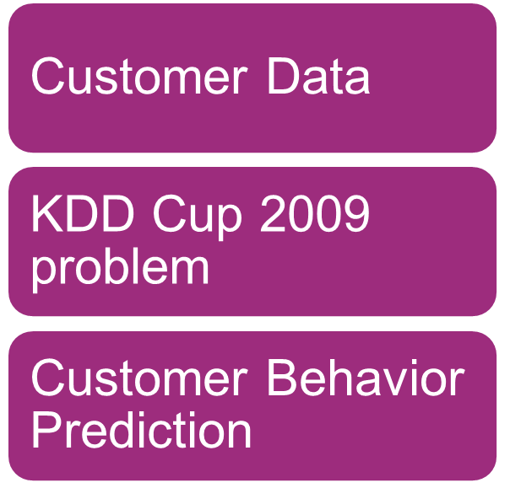
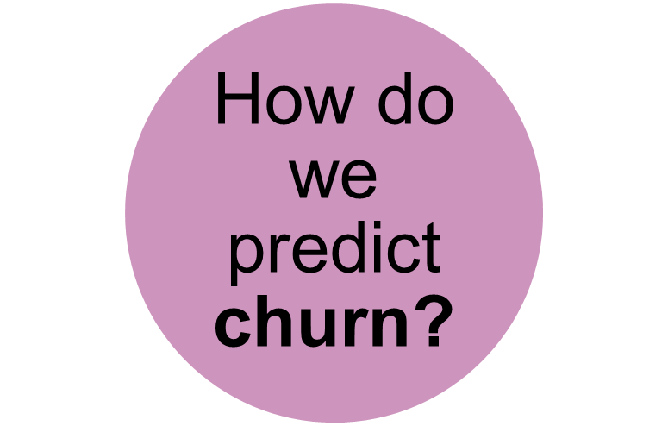
The Context

Slide 3
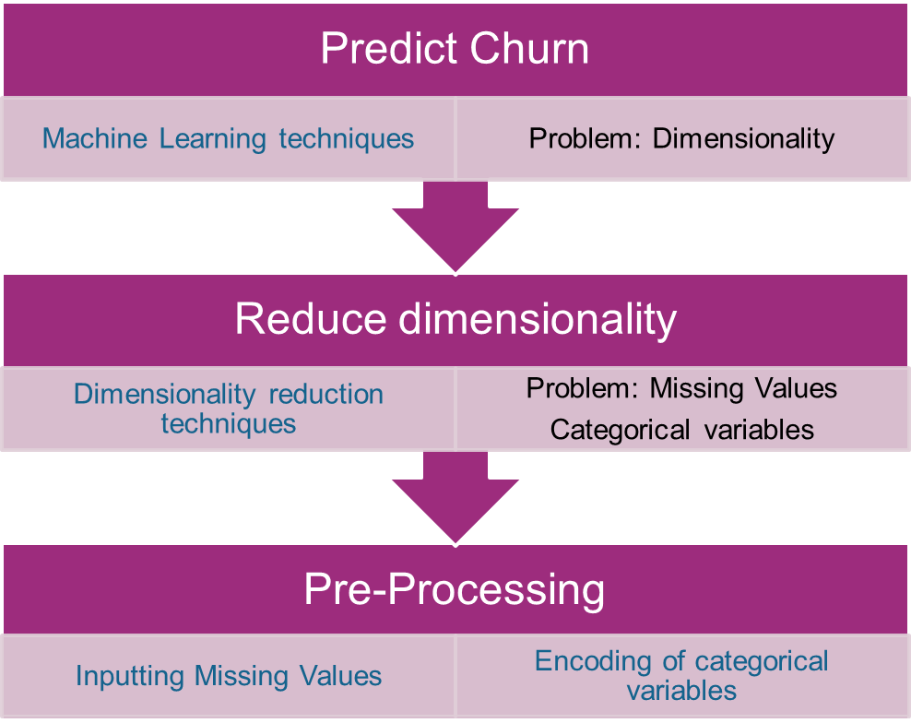
Challenges and Solutions

Slide 4
The Workflow
Preprocessing
Dimensionality Reduction
Classification
Gradient Boosting Trees
One-Hot-Encoding
Missing Value Filter
Principal Component Analysis
Random Forest
Data
Binary Encoding
High Correlation Filter
Logistic Regression
Feature Importance Ranking
Neural Networks
Missing Values Imputation
Low Variance Filter
Support Vector Machine
<number> / evalueserve.com
©2018 Evalueserve. All rights reserved.

Slide 5


The Data
Variables | Large | Small
Numerical | 14,740 | 190
Categorical | 260 | 40
Notes:
garbage-in-garbage-out

Slide 6
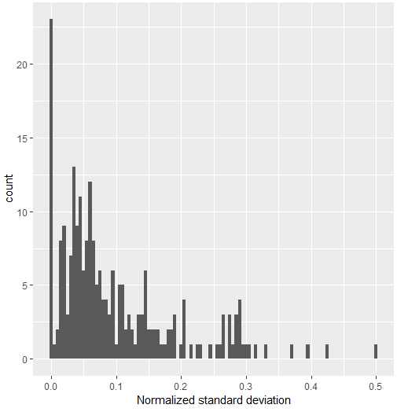
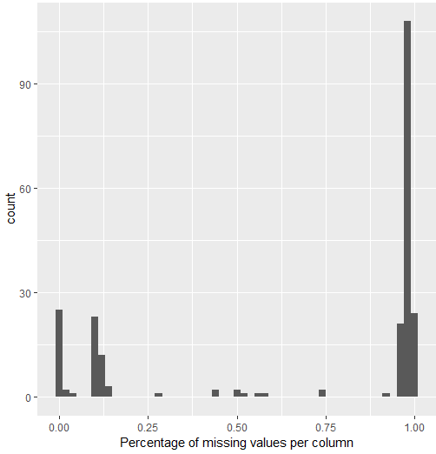
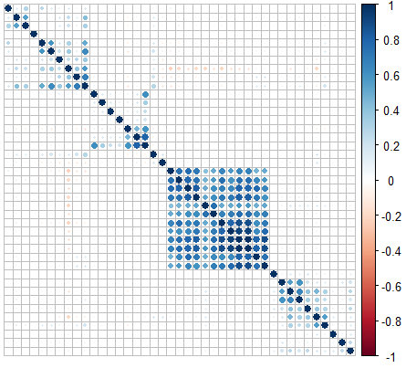
Reviewing the data
Observations
23 variable with zero standard deviation, i.e. containing just one value, or very small deviation
More than 150 variables with very high percentage (>90%) of missing values
Less than 30 variables do not have any missing values
Many correlated variables
<number> / evalueserve.com

Slide 7

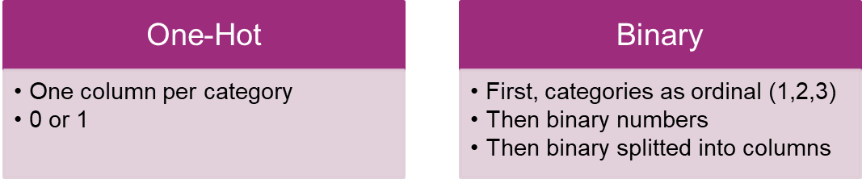
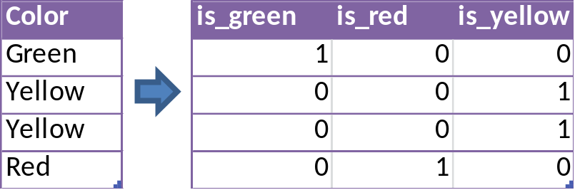
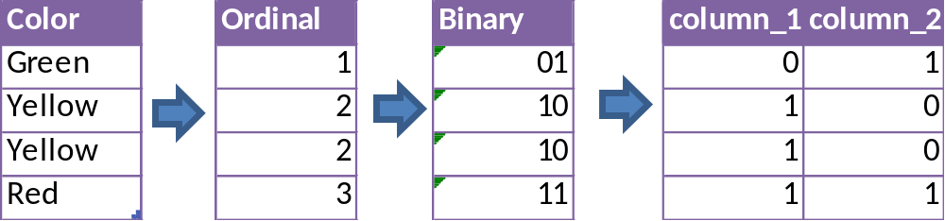
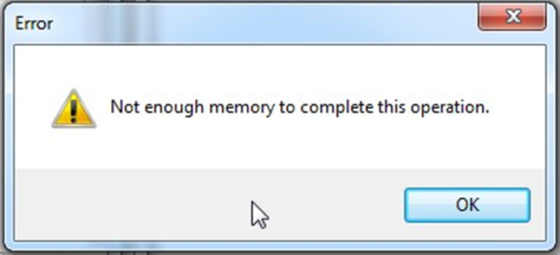
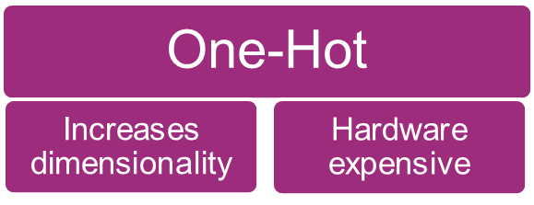
Encoding Categorical Variables
<number> / evalueserve.com
Notes:
One-Hot is counterproductive , as we are creating a lot of new variables we are moving away from the objective of reducing dimensionality, and the process is hardware expensive.

Slide 8

Binary Encoding Results
Model | Binary Only | Category-to-Other | % of difference
Random Forest | 0.7337 | 0.7331 | -0.082
Gradient Boost Trees | 0.7428 | 0.7392 | -0.485
Support Vector Machine | 0.6866 | 0.6838 | -0.408
Neural Network | 0.6114 | 0.6203 | 1.456
Logistic Regression | 0.6714 | 0.67 | -0.209
<number> / evalueserve.com

Slide 9
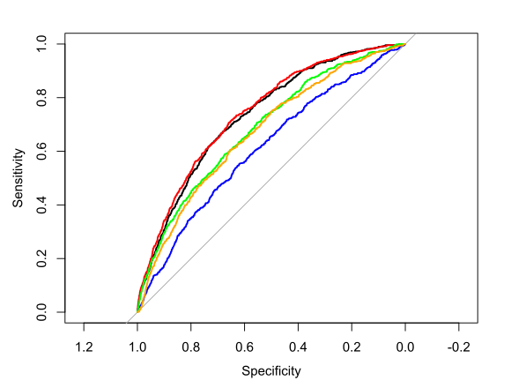
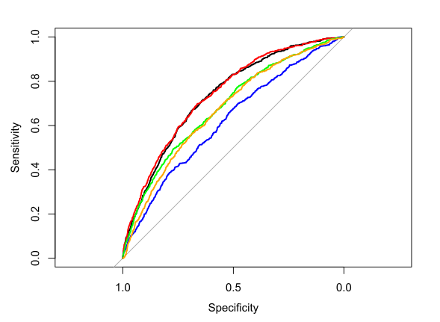
ROC Curve comparison
Binary Encoding Only
Category-to-Other & Binary Encoding
<number> / evalueserve.com

Slide 10
One Hot Encoder Results
Model | Category To Other + One Hot
Random Forest | 0.7337
Gradient Boost Trees | 0.7428
Support Vector Machine | 0.6866
Neural Network | 0.6114
Logistic Regression | 0.6714
<number> / evalueserve.com

Slide 11
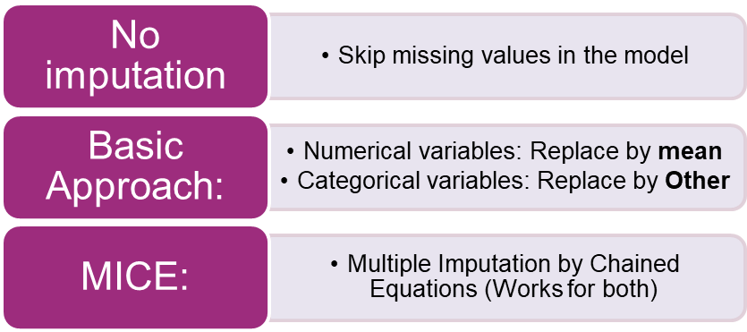
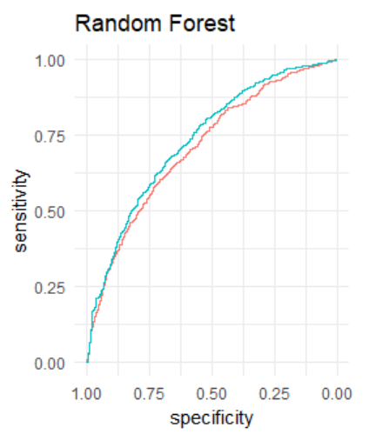
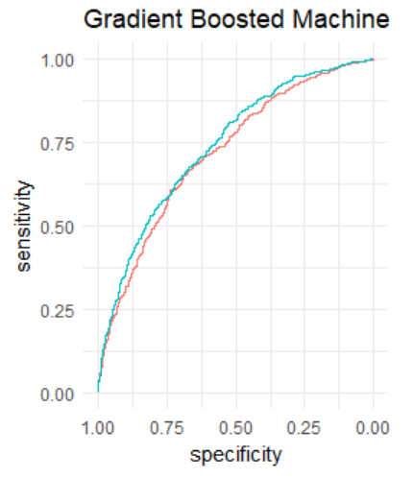
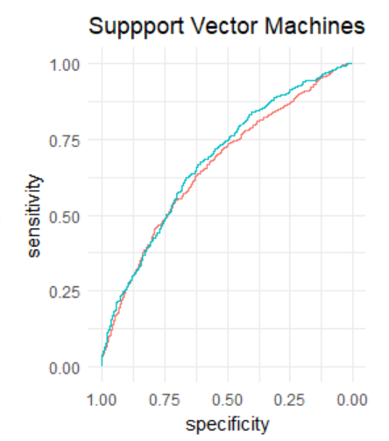
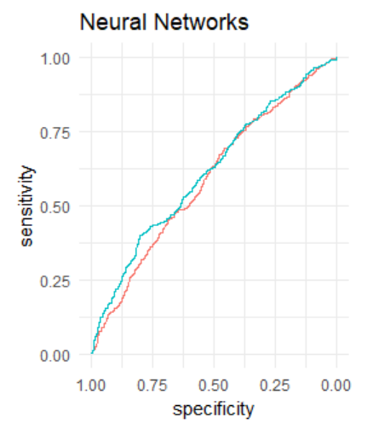
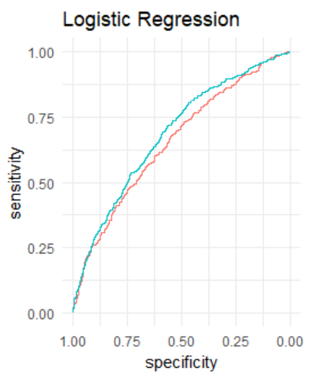


Missing Values Imputation
Some of the best Machine Learning models do not support NA values: What did we do?
AUC | Basic Imputation | MICE | % of difference
Random Forest | 0.710 | 0.735 | 2.5%
Gradient Boosted | 0.719 | 0.741 | 2.2%
Support Vector Machine | 0.663 | 0.681 | 1.8%
Neural Network | 0.593 | 0.616 | 2.3%
Logistic Regression | 0.655 | 0.685 | 3.0%

Slide 12
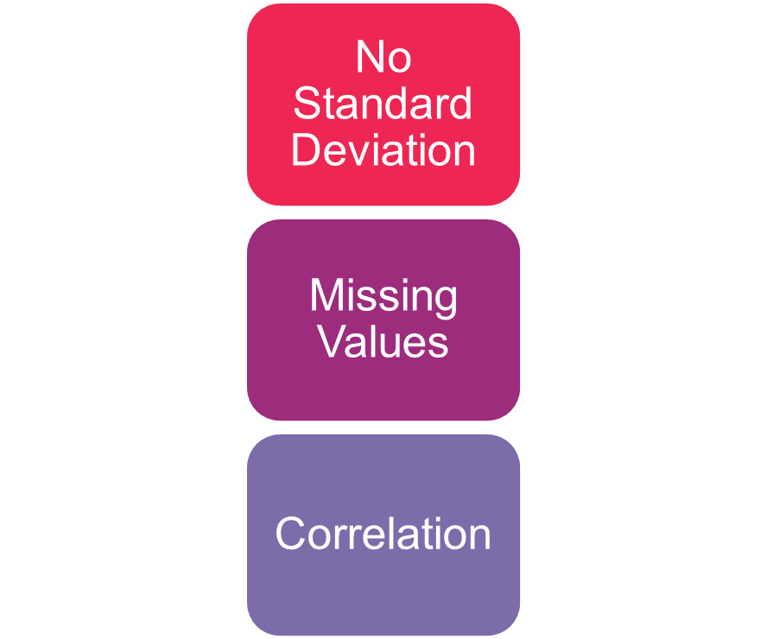
Column Filters
Missing Values | 0% | 10% | 50%
Random Forest | 0.714 | 0.714 | 0.716
Gradient Boosted | 0.725 | 0.725 | 0.726
Support Vector Machine | 0.672 | 0.679 | 0.673
Neural Network | 0.634 | 0.642 | 0.624
Logistic Regression | 0.674 | 0.680 | 0.675
Purposes:
Dimensionality Reduction
Efficacy: Comparison vs Benchmark performance
Efficiency:
Time Management
Correlation Filter | 75% | 90% | 100%
Random Forest | 0.716 | 0.714 | 0.711
Gradient Boosted | 0.726 | 0.725 | 0.723
Support Vector Machine | 0.679 | 0.678 | 0.678
Neural Network | 0.624 | 0.642 | 0.628
Logistic Regression | 0.680 | 0.679 | 0.678

Slide 13
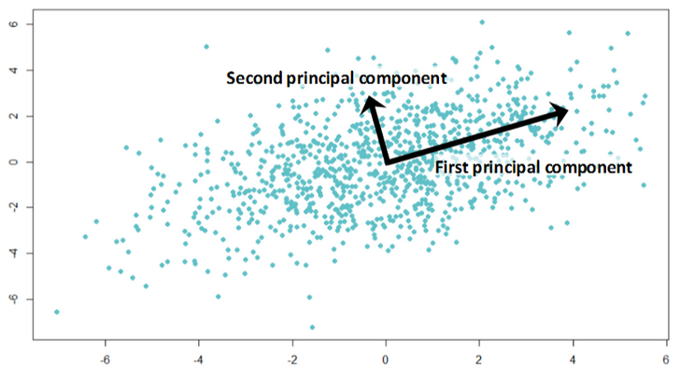
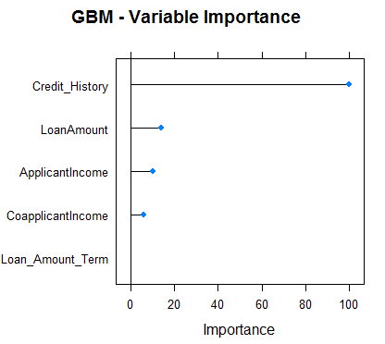
PCA vs VarImp
Principal Component Analysis (PCA)
find new axes in the data
the first principal component is along the direction with most variance among the data
each principal component is orthogonal to the others.
Advantage: dimensionality reduction without too much information loss
Disadvantage: loss of interpretability of the variables
Variable Importance Ranking (VarImp)
evaluation of the performance of each individual variable in a random forest classifier
“which trees was the variable part of, and how good did these predict?”
rank the variables along this evaluation
Advantage: qualitative measure to see the importance of each variable
Disadvantage: possible loss of variables that contain information
<number> / evalueserve.com

Slide 14
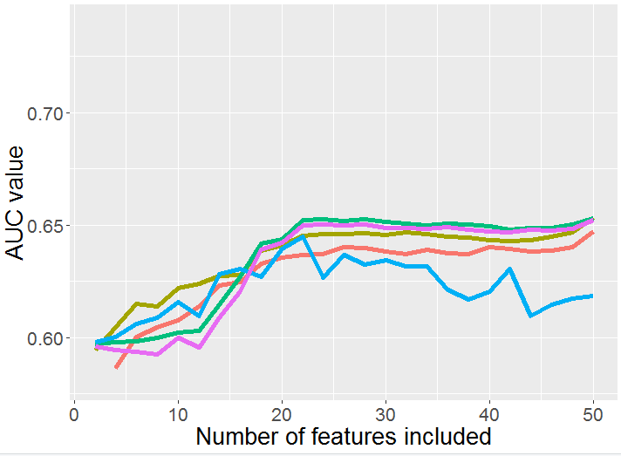
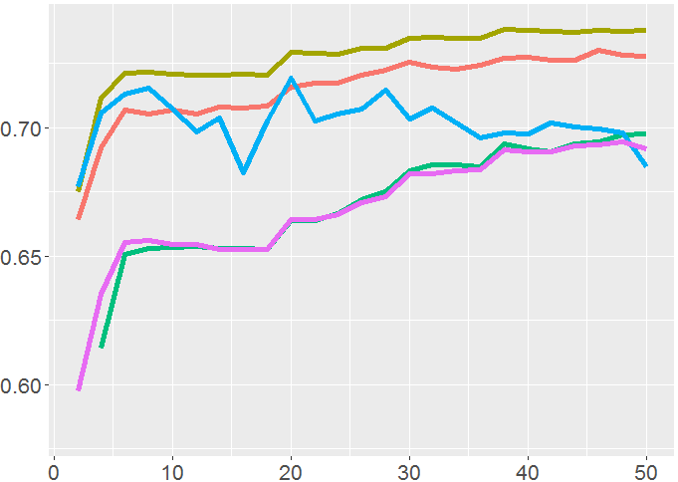
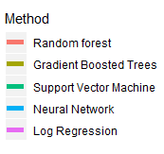
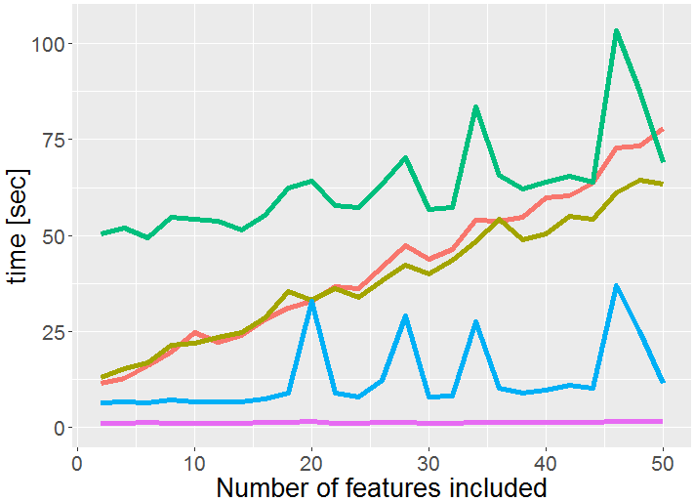
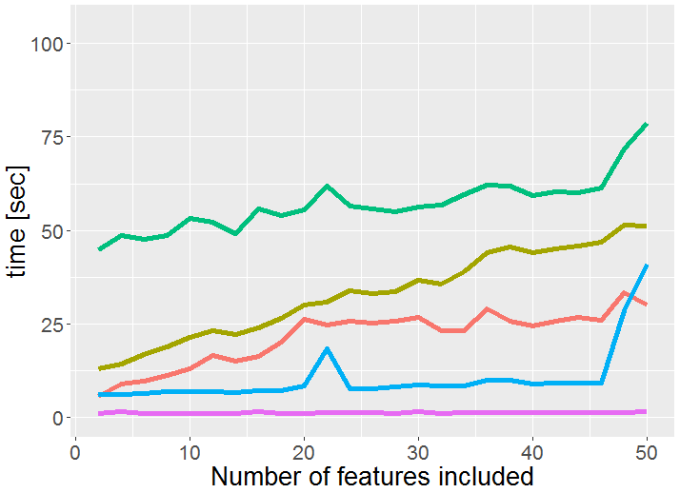
PCA vs VarImp Results
PCA
VarImp
<number> / evalueserve.com

Slide 15
What’s next?
Bootstrap
MCA and / or MFA
Paralleling Comparisons
Hierarchical and / or K-Means Clustering
Caret Recipe Methods
Large Dataset
Documentation
<number> / evalueserve.com

Slide 16
Thank you!
Although the information contained in this publication has been obtained from sources believed to be reliable, the author and Evalueserve disclaim all warranties as to the accuracy, completeness or adequacy of such information. Evalueserve shall have no liability for errors, omissions or inadequacies in the information contained herein or for interpretations thereof.

